Slide 1
AIML Project Predicting Stock Prizes
Team Members
Team Member 1: 2210990738 (Rohan Kapoor)
Team Member 2: 2210990722 (Rhythm Trehan)
Team Member 3: 2210990129 (Anmol Singla)
Team Member 4: 2210990136 (Ansh Khurana)

Slide 2
CONTENT
Problem Statement
Objective
Tools Used
Data Summary
Exploratory Data Analysis
Challenges
Recommendations
Conclusions

Slide 3


PROBLEM STATEMENT
Predicting stock prices is a complex task due to the dynamic nature of financial markets and the involvement of numerous unpredictable factors .The financial markets are dynamic and influenced by various factors, making stock price prediction a challenging yet crucial task for investors and traders.
In this project, we aim to develop a robust time series forecasting model to predict stock prices based on historical market data. The focus will be on leveraging machine learning algorithms such as ARIMA, LSTM, or Prophet to make accurate and reliable predictions.

Slide 4
OBJECTIVE
Develop a robust time series forecasting model for predicting stock prices using historical market data. The project involves comprehensive data preprocessing , effective feature engineering , and experimentation with advanced algorithms such as ARIMA, LSTM, or Prophet. The primary goal is to create a reliable model that accurately predicts future stock prices , enabling informed investment decisions.

Slide 5
Tools Used
Google collab is used as IDE.
import pandas as pd
import numpy as np
import matplotlib.pyplot as plt
import seaborn as sns
import plotly.express as px
import plotly.offline as pyo
import plotly.graph_objs as go
GitHub is used as version control system

Slide 6
DATA SUMMARY
Numerical Data:
Open
High
Low
Close
Volume
Adj Close
Categories
Categorical Data:
Date
Unique Values:
Date

Slide 7
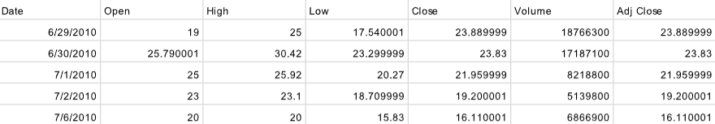
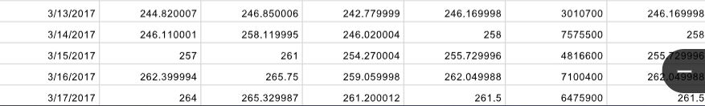
DATA SUMMARY
This is the Stocks dataset. In the below table it shows the top and bottom 5 rows respectively

Slide 8
FEATURES DESCRIPTION
Date: The date of the market data.
Open: The opening price of the stock on the given date.
High: The highest price of the stock during the trading day.
Low: The lowest price of the stock during the trading day.
Close: The closing price of the stock on the given date.
Volume: The trading volume, representing the total number of shares traded on the given date.
Adj Close: The adjusted closing price, accounting for factors such as dividends and stock splits.

Slide 9
FEATURES DESCRIPTION
Date: Categorical feature representing the date of the recorded data.
Open: Continuous numerical feature indicating the opening price of the stock.
High: Continuous numerical feature representing the highest price reached by the stock during the trading day.
Low: Continuous numerical feature indicating the lowest price reached by the stock during the trading day.
Close: Continuous numerical feature representing the closing price of the stock.
Volume: Discrete numerical feature representing the total number of shares traded on a given date.
Adj Close: Continuous numerical feature representing the adjusted closing price, accounting for corporate actions.
Data Range: The dataset covers market data from June 29, 2010, to March 17, 2017 providing a historical perspective on the stock's performance.
Data Granularity: The data is recorded on a daily basis, capturing the stock's behavior at the end of each trading day.

Slide 10
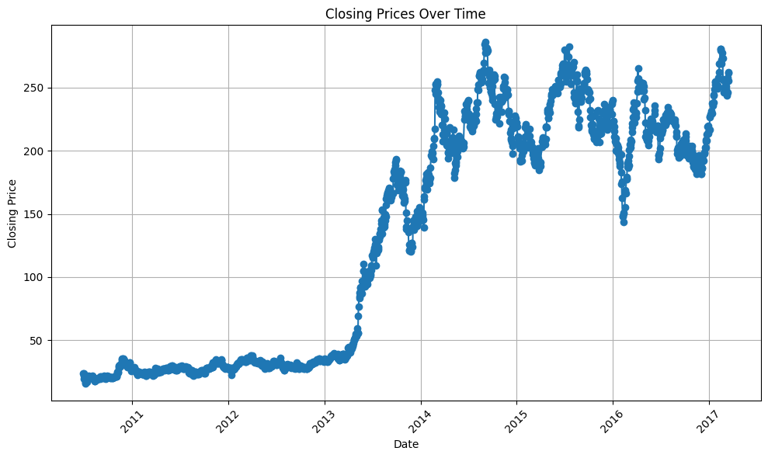
Line plot to visualize the closing prices over time.
Line plots are suitable for showing how a particular variable changes over a continuous range of values.
Positive Business Impact: By understanding the trend, volatility, and key turning points in the stock's price movement, investors and traders can make more informed decisions about when to buy, sell, or hold the stock. This can potentially lead to better investment outcomes and increased profitability.
Negative Business Impact: Insights might lead to negative growth of the company as well. For ex: if the chart reveals a consistent downtrend or encounters resistance at key price levels, it may signal underlying weaknesses in the company's fundamentals or market sentiment. This could result in negative growth as investors lose confidence in the stock's potential for future appreciation.

Slide 11
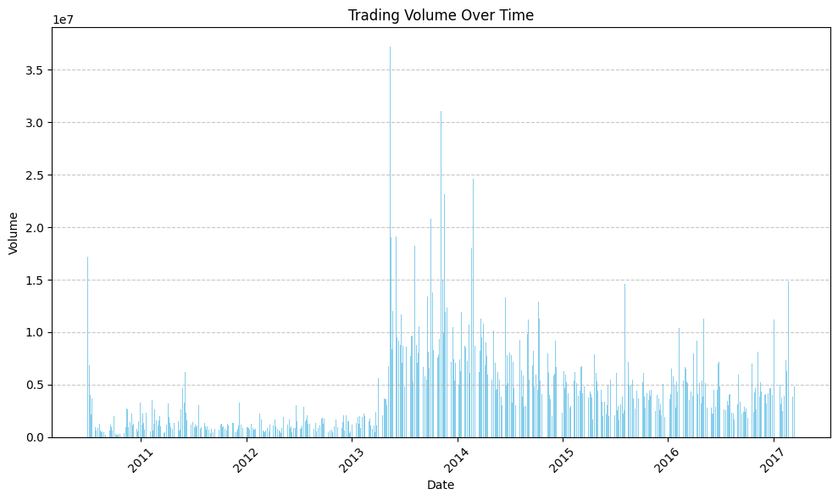
Bar plot to visualize the trading volume over time
Bar chart to visualize the trading volume over time because it effectively displays the level of trading activity for the stock on each trading day. Why this chart was chosen:
1) Quantitative Comparison 2) Highlighting Peaks and Troughs
3) Simple and Intuitive 4) Clear Presentation of Data
Any insights that lead to negative growth?
There can be a negative growth impact from the plot as for ex: persistent low trading volumes, especially during price declines, may indicate a lack of investor interest or support for the stock. This could lead to negative growth as reduced trading activity may result in wider bid-ask spreads, making it more challenging for investors to execute trades at favorable prices.

Slide 12
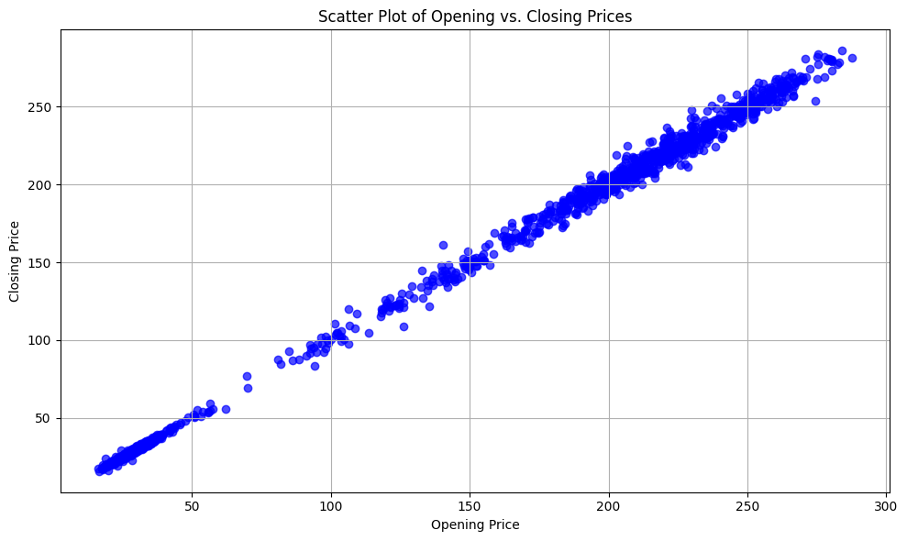
Scatter Plot - Opening vs Closing Prices
Scatter plot to visualize the relationship between opening and closing prices because it allows us to explore the correlation between these two variables for each trading day.
From the scatter plot showing the relationship between opening and closing prices, several insights can be inferred:
Positive Correlation
Negative Correlation
Outlier Detection
Trend Identification

Slide 13
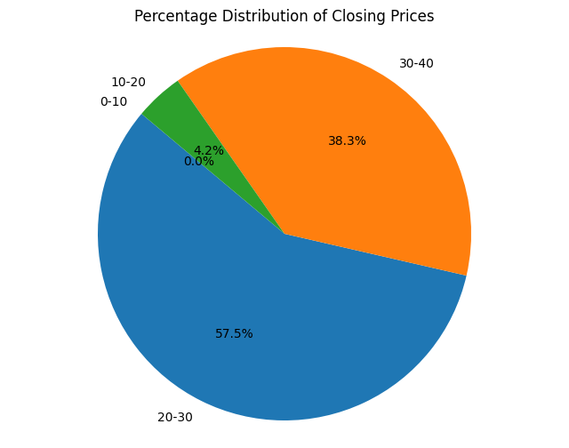
Pie Chart – Percentage Distribution of Closing Prices
Pie Chart is suitable for illustrating the percentage distribution of a categorical variable, in this case, the percentage distribution of closing prices within certain price ranges.
Insights gained from the pie chart include the percentage distribution of closing prices within specific price ranges. This helps in understanding how the closing prices are distributed across different price levels. For example, you can see what percentage of closing prices fall within the range of 0-10, 10-20, 20-30, etc.

Slide 14
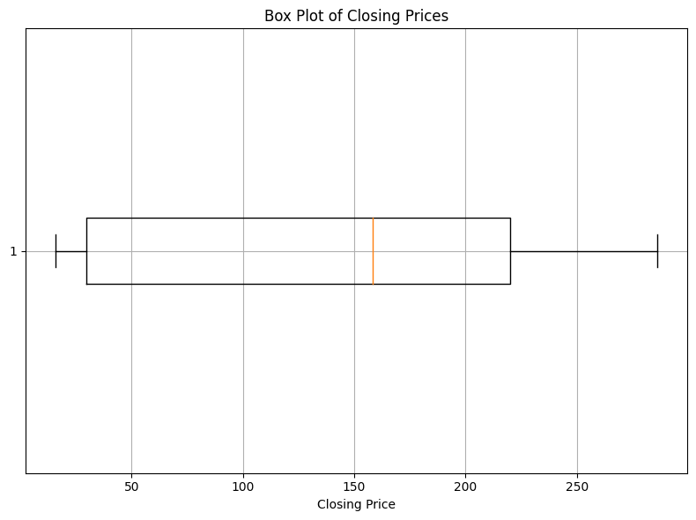
Box Plot -visualize the distribution of closing prices
Box Plot provides a concise summary of the central tendency, spread, and variability of the dataset. Box plots are effective for identifying outliers and understanding the overall distribution of the data, making them useful for exploring the variability in closing prices over the specified time period.
Insights from the box plot:
Central Tendency
Variability
Outliers

Slide 15
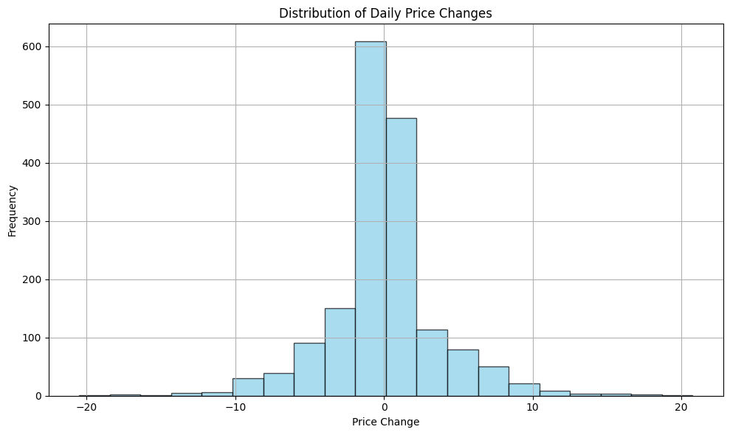
Histogram -visualize the distribution of daily price changes
Histogram to visualize the distribution of daily price changes because it provides insights into the frequency and magnitude of price movements within a given range. Histograms are effective for displaying the distribution of numerical data and are particularly useful for identifying patterns, outliers, and the overall shape of the distribution.
Insights from the histogram:
Frequency of Price Changes
Distribution of Price Changes
Identification of Outliers:

Slide 16
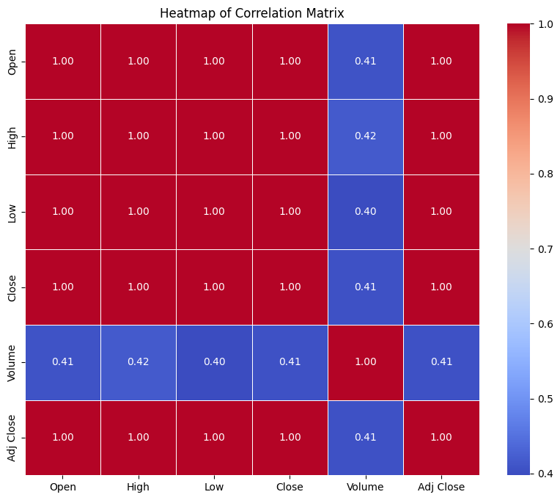
Heatmap to visualize the correlation matrix
Heatmap to visualize the correlation matrix because it provides a clear and concise overview of the relationships between different variables in the dataset. Heatmaps are particularly effective for identifying patterns, dependencies, and correlations within complex datasets, making them a useful tool for exploratory data analysis.
Insights from the Heatmap:
Strength of Correlation
Direction of Correlation
Identifying Patterns

Slide 17
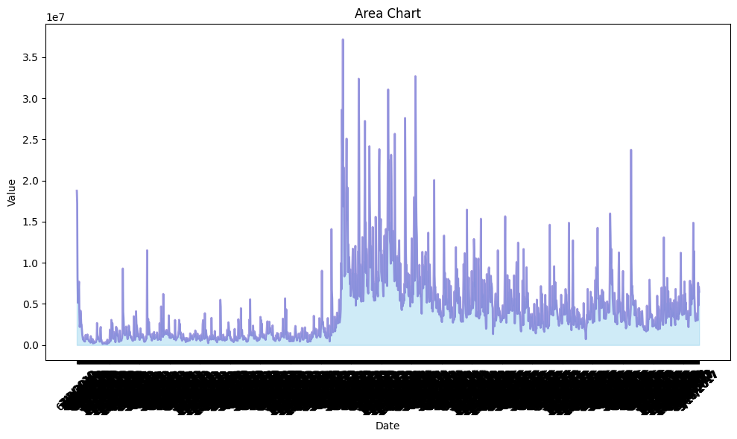
Area chart - Trends and magnitude of a dataset over time
An area chart effectively shows the trend and magnitude of a dataset over time. The filled area under the line makes it easy to visualize the cumulative effect or the total value of the data at different points in time.
Insights from the area chart include understanding the trend and magnitude of the dataset over the given time period. In this case, the chart shows how the value represented by the dataset evolves over time. It can reveal patterns such as upward or downward trends, periods of stability, or significant fluctuations.

Slide 18
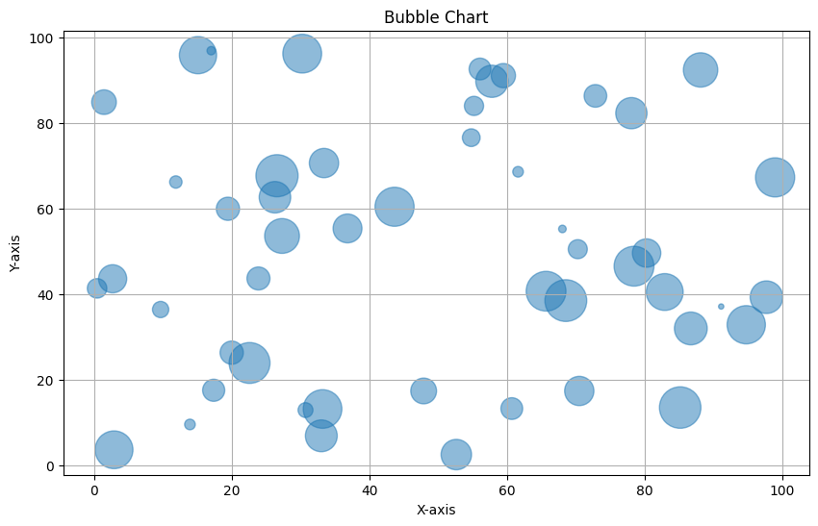
Bubble chart -visualizing 3D data in a 2D space
Bubble chart is used because it's useful for visualizing three-dimensional data in a two-dimensional space. The x and y coordinates represent two variables, and the size of each bubble represents a third variable. This type of chart can effectively show the relationship between multiple variables simultaneously.
Insights from the bubble chart include understanding the distribution and relationship between the three variables represented by the x-axis, y-axis, and bubble size. By observing the position and size of each bubble, we can identify patterns, clusters, or outliers in the data. For example, if larger bubbles tend to cluster in a particular region of the plot, it may indicate a concentration of data points with high values for all three variables.

Slide 19
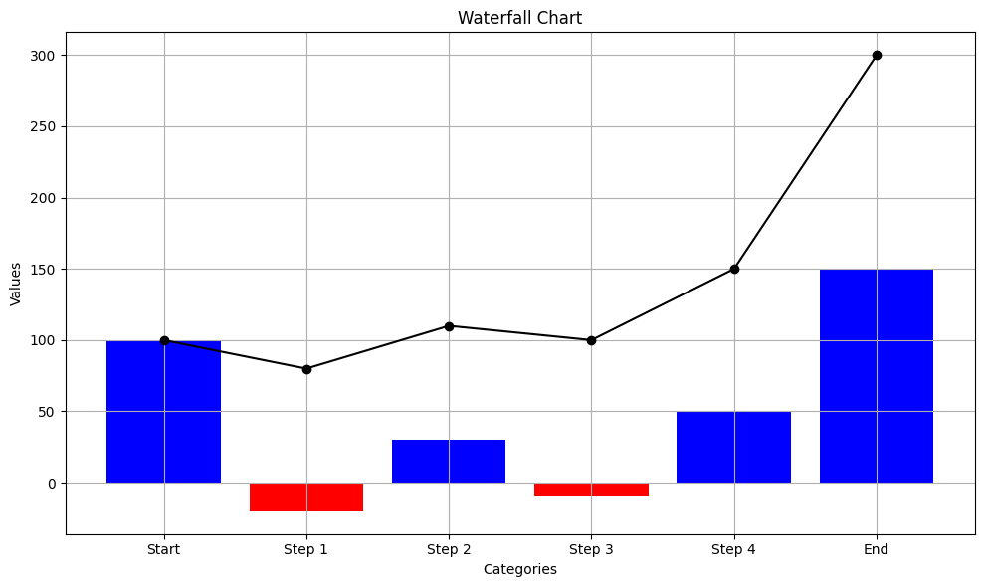
Waterfall chart -visualizing cumulative effect of positive and negative values
We picked the waterfall chart because it's particularly effective for visualizing the cumulative effect of positive and negative values over a series of steps or categories. It provides a clear representation of how each step contributes to the overall change, making it useful for analyzing financial data, budgeting, and performance tracking.
Insights from the waterfall chart include understanding the contributions of individual steps or categories to the overall change. By observing the heights and positions of the bars, we can identify which steps have the most significant impact on the final outcome. Additionally, the chart helps in visualizing the direction of change at each step.

Slide 20
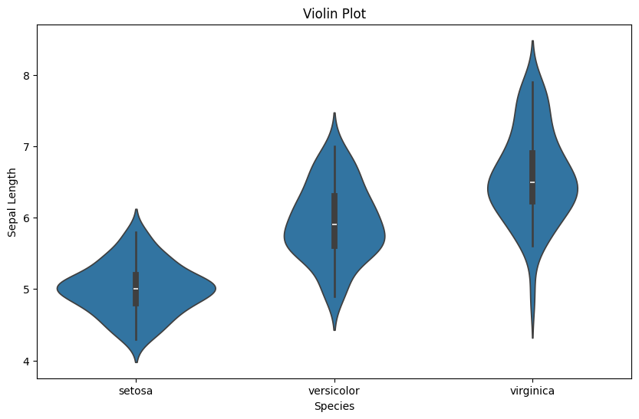
Violin plot - to compare the distribution of sepal lengths across different species of iris
We chose the violin plot because it's particularly useful for visualizing the distribution of a continuous variable across multiple categories or groups. In this case, the violin plot allows us to compare the distribution of sepal lengths across different species of iris in a single plot.
The gained insights from the violin plot can help in making informed decisions that could potentially lead to positive business impacts. For example, if the violin plot reveals distinct differences in the sepal length distributions between different species of iris, it may indicate unique characteristics or preferences associated with each species

Slide 21
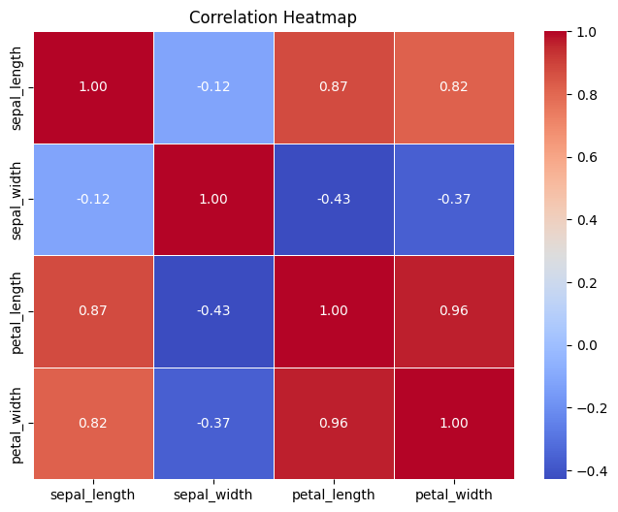
Correlation heatmap- visualizing pairwise relationships b/w variables in dataset
I chose the correlation heatmap because it's a powerful tool for visualizing the pairwise relationships between variables in a dataset. The correlation heatmap allows us to quickly identify which variables are positively correlated, negatively correlated, or uncorrelated with each other. This visualization is particularly useful for understanding the dependencies and interactions between variables, which can inform data analysis, modeling, and decision-making processes
Insights from the correlation heatmap include:
Identifying variables that are strongly positively correlated, indicating that they tend to increase or decrease together. For example, in the Iris dataset, we may observe a strong positive correlation between petal length and petal width. Identifying variables that are strongly negatively correlated, indicating an inverse relationship between them.

Slide 22
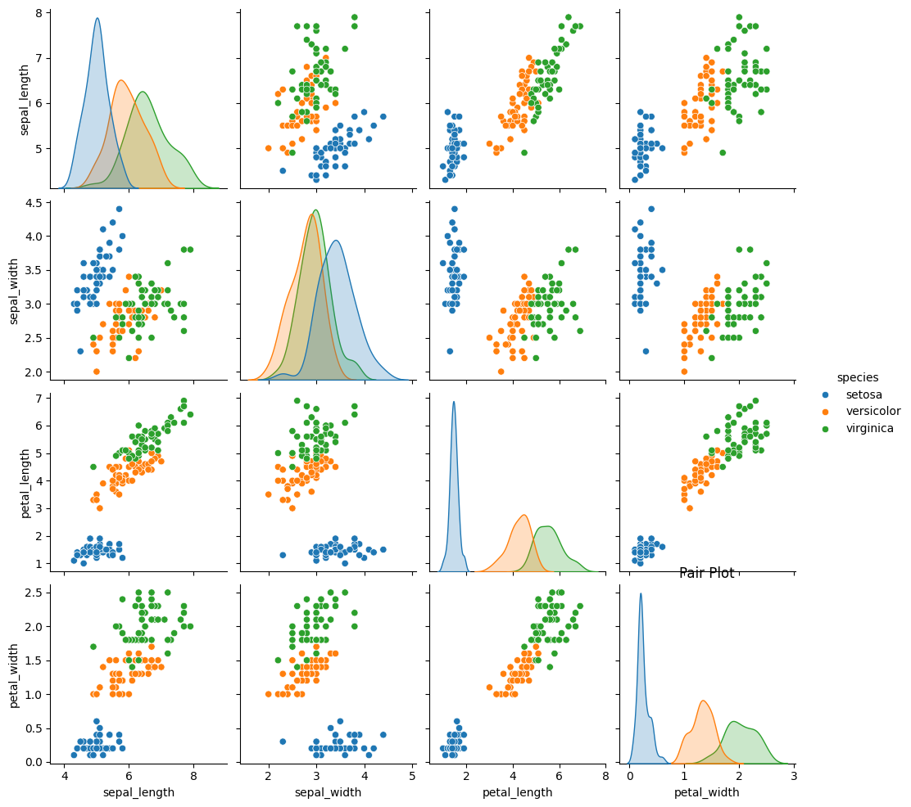
Pair plot -visualizing pairwise relationships b/w multiple variable in dataset
Pair plot is an excellent tool for visualizing pairwise relationships between multiple variables in a dataset. The pair plot allows us to quickly examine how each variable correlates with every other variable in the dataset. It's particularly useful for exploring potential patterns, trends, or dependencies between variables, making it a common choice for exploratory data analysis.
Insights from the pair plot include:
Identifying correlations: By examining the scatter plots on the diagonal, we can assess the relationship between each variable and itself and visually inspect the distribution of each variable. Off-diagonal scatter plots show the relationship between pairs of variables, allowing us to identify correlations or patterns between them.

Slide 23
Challenges
We faced Difficulty to get more insights from small data set.
The columns in the dataset took some time to understand and also we have done some research work to understand the Airbnb and it’s business in order to get useful insights .
Have lesser categorical data.

